Slide 1
Isaac capes portfolio
Showing off my computing skills and work.

Slide 2
Index
Index
Introduction
College coursework (HTML, CSS, PHP & Documentation)
Cyber Security online course at Teesside University
Creating a network (packet tracer)
UML (group project)
SQL queries
Programming (python)
Contact

Slide 3
Introduction
A second year student studying cyber security at Teesside University. I have the CCNA: Introduction to networks certificate and now studying for CCNA: Switching, routing and wireless essentials and Microsoft azure exam which are all provided by the university. I love building computers and learning new software.
This portfolio is a summary. If you would like to read each project in more detail, there are documents in the zip file titled accordingly.

Slide 4
College coursework - Introduction
At bede sixth form college, part of my A-Level was to create a computing project. I enjoy football and the app ‘Fantasy Premier league’ where you get to choose players and get points based off their performance and can play again friends. So for my project, I decided to do a game similar to this, but you must predict the scores and get points if you get the correct score and can play against friends. I used CSS, HTML and PHP. More detail about this coursework is in the zip file.

Slide 5
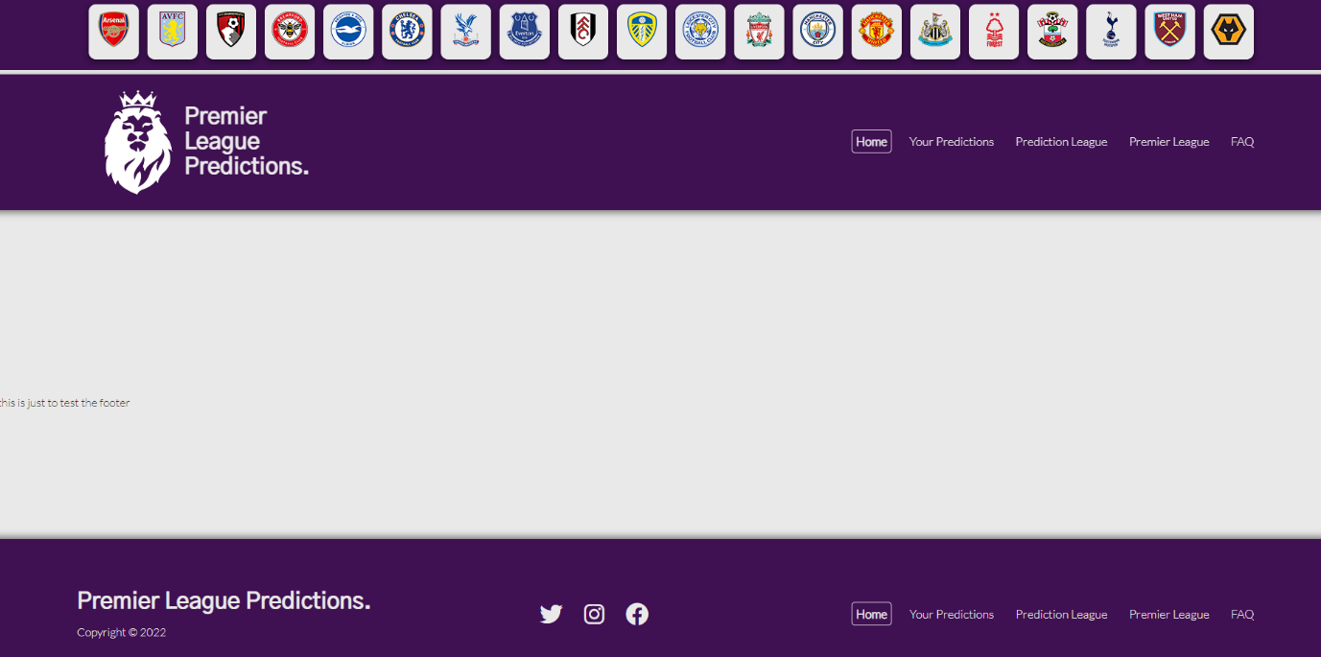
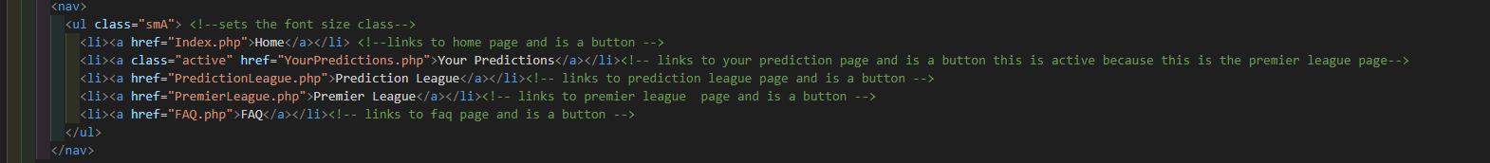
College course work – master page
I used a colour scheme and a lot of images to attract new people to the website. All the football badges at the top link to the official websites.
The source code below is for the buttons at the top

Slide 6
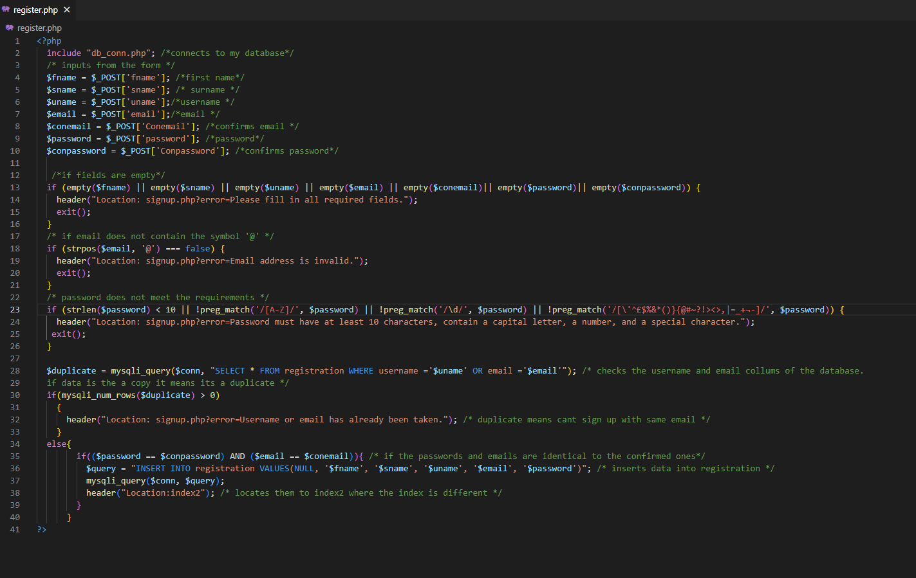
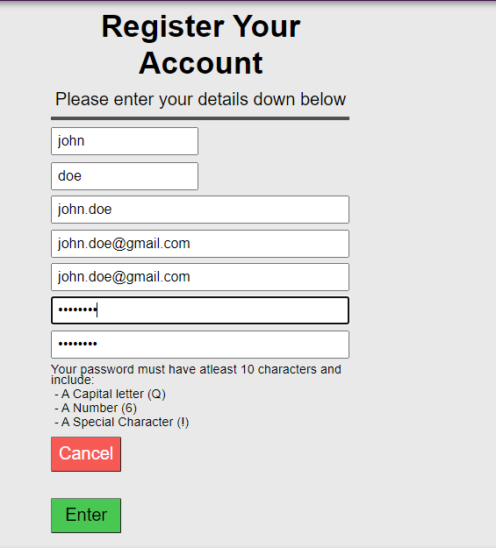

College coursework – Register account
The source code to the right is for the registration page. Using php, I had to ensure that all the boxes were filled in, and the password requirements were met. If this worked then their username and password would be inserted into a database called users. There are also error codes if a user does not enter anything for the username for example.
The example below was testing to see if the insert would work without password requirements.

Slide 7
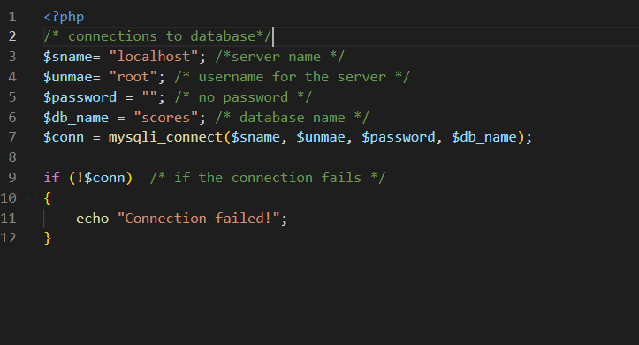
College coursework – conclusion
The source code to the right is to connect the database so that I do not need to repeat the code. The database is called scores.
All the code in this project is very similar. I just wanted to show you that most of the code is very similar with a website and you really only need to modify it for the needs of the page. This was the first real computing project I did, as well as an official write up.

Slide 8
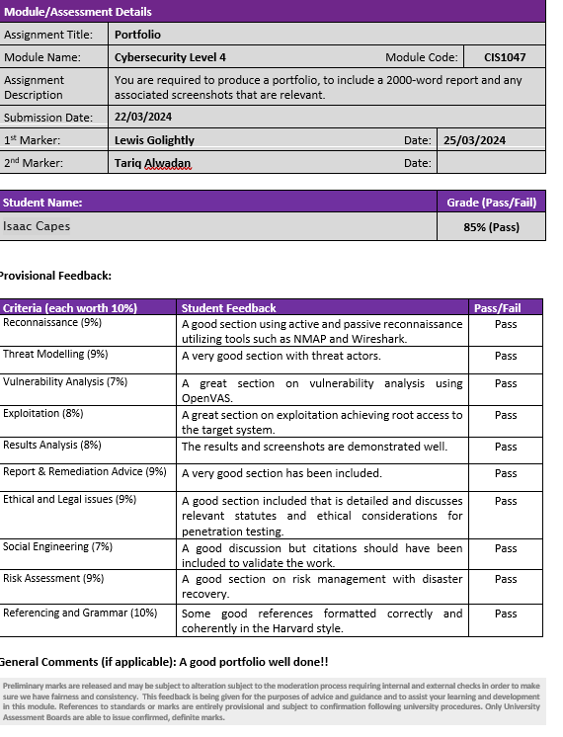
Cyber security online course
I passed this course at Teesside University with 85%

Slide 9
Cyber security online course - introduction
Completed this course in January 2024 and finished in March 2024. I had to use kali Linux (penetration tester) and metasploitable 2 (target machine) and used various tools such as wireshark and OpenVAS. A disaster recovery plan, scope, rules of engagement is mentioned in the writeup along with many threat actors that could attack the machine. As it was an official Teesside university course and I passed with 85% and was worth 10 credit points.

Slide 10
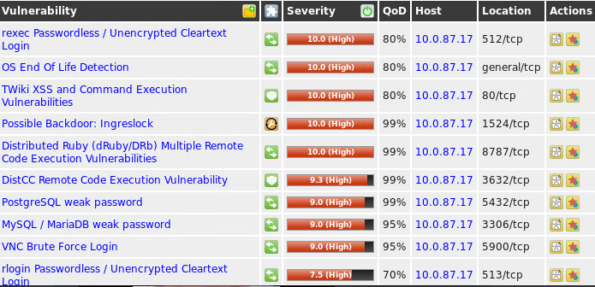
Cyber security online course – openVAS
Openvas was used here to detect vulnerabilities of a target machine. From here, I could see that the main vulnerabilities are that encryption is not used for logins and can execute shell commands, and the OS is out dated.

Slide 11
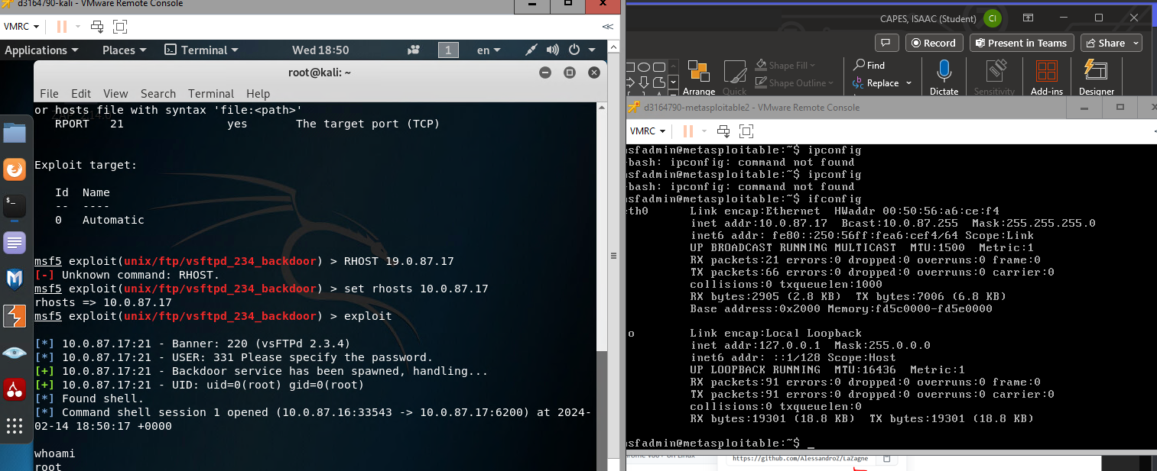
Cyber security online course - exploitation
Accessing metasploitable by using port 21. The left image is a kali machine. Commands before this image were ‘msfconsole’, and ‘use vsftp’. From here, I could execute commands as the metasploitable machine from the kali machine. To verify that I was on the metasploitable 2 machine on the kali machine, I executed this command.

Slide 12
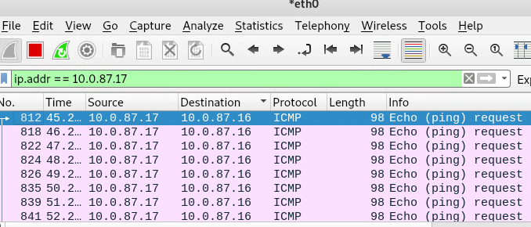
Cyber security online course - Wireshark
Wireshark here is used to analyse network traffic. The target machine IP address is 10.0.87.17 and this worked because the Kali machine was on the same network. However it can be used to verify network applications and analyse security problems. Wireshark also has filters so I could find even more vulnerabilities.

Slide 13
Cyber security online course - conclusion
A disaster recovery plan should be made for every company in case of a cyber attack and even physical damage such as a natural disaster. Legal issues is also covered so that nothing illegal is done when penetration testing.
Overall this was a fun course to complete and given me a good incite into the cyber security industry and how to ethically hack.

Slide 14
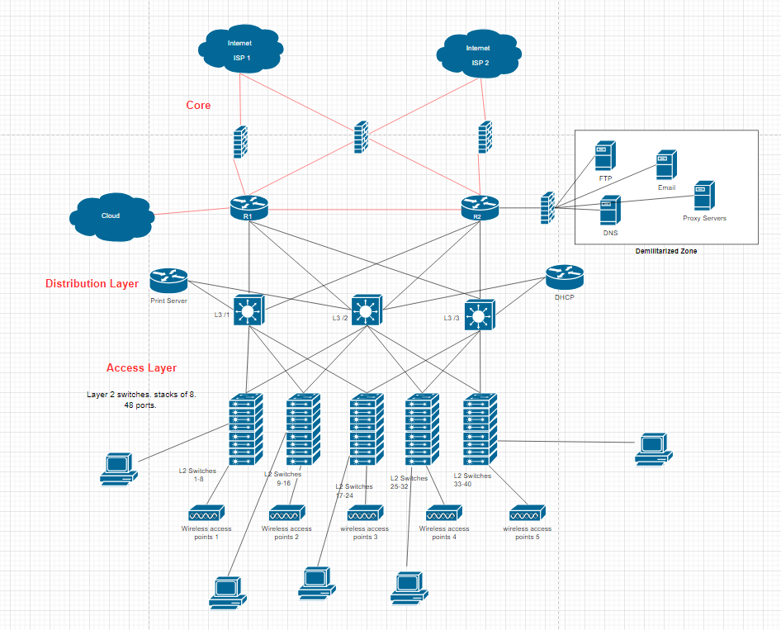
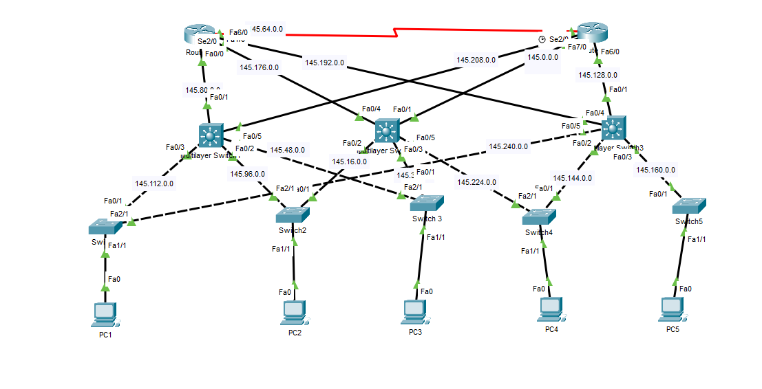
Creating a network
This is a network for 1400 people and was completed on packet tracer

Slide 15
Packet tracer - Introduction
Having no prior experience with packet tracer, learning this software was challenging but rewarding. I had to implement subnetting, security and physical security, with the 3 different network layers. A logical and implementation design was created for this network. I passed this assignment with 85% at university.

Slide 16
Packet tracer – logical design
The red lines in this diagram represent fibre optic cables and the black lines represent cat5e cables. Switch stacks are used to so that more space in the room is available and the switch stack will use 1 IP address. It shows the 3 layers of the image, and the DMZ where servers are held.

Slide 17
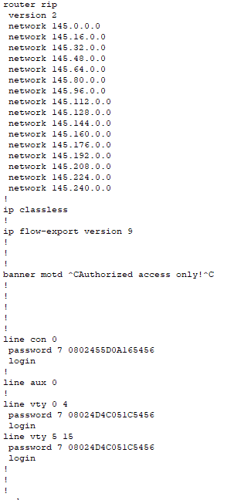

Packet tracer – implementation design
This diagram shows the subnets of the diagram. Each device in the network can successfully ping to any device because of the configurations in the switches.
This image here is a part of the router configuration. This allows subnets to communicate to each other and is a secure router because of the motd, and line vty lines.
The image below is a successful ping to another subnet

Slide 18
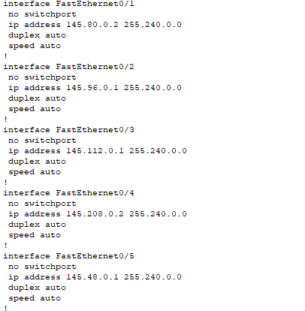
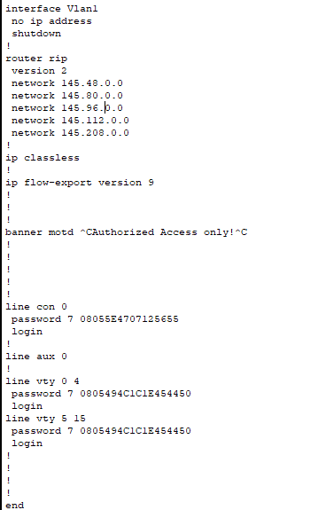
Packet tracer – layer 2/3 switch config
All the configurations are very similar with layer 2 and layer 3 switches. Only thing that is different is layer 3 switch that allows the adjacent subnets to be able to communicate. Every ethernet port being used in the layer 3 has to be in the “router rip version 2”.

Slide 19
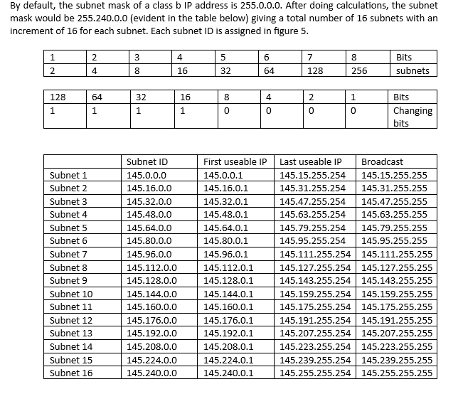
Packet tracer - subnets
The table is a subnet. Subnetting is hard to do and using this table helped me a lot.

Slide 20
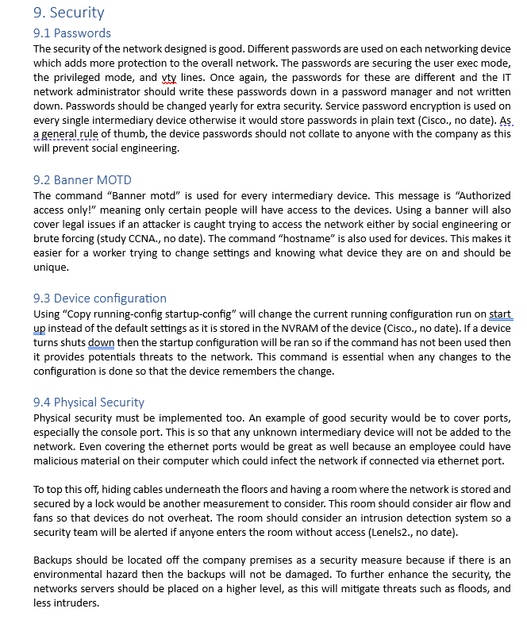
Packet tracer – security
As mentioned before security was a big aspect of this. All of these headings are just as important as each other. Physical security is not mentioned enough in cyber security but I think it should be talked about more.

Slide 21
UML - Introduction
This was a group assessment at university. The group project was making wireframes, entity relation diagrams, sequence diagrams, class diagrams and use case diagrams for a proposed idea of the NHS app. Our group presentation was so good that our module leader got industry in, and post-graduate software developers students to look over our work. They all said that our work was up to a professional standard. I chose to do a registration and an online shopping page.

Slide 22
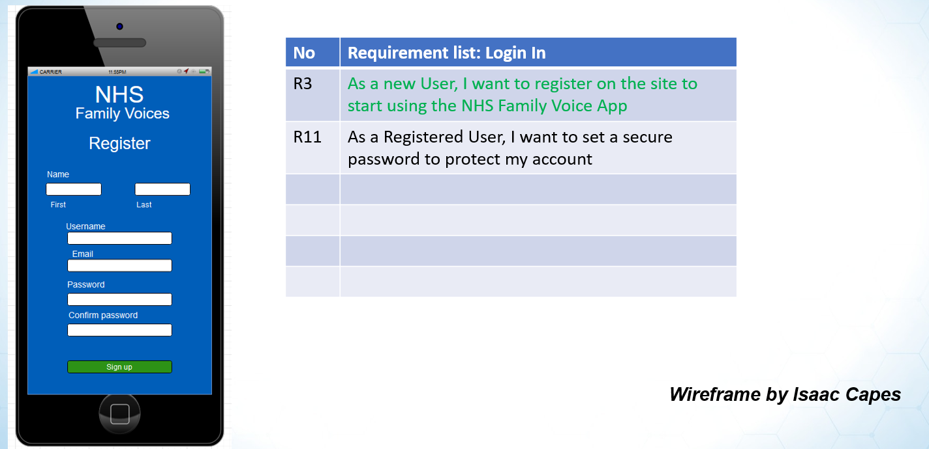
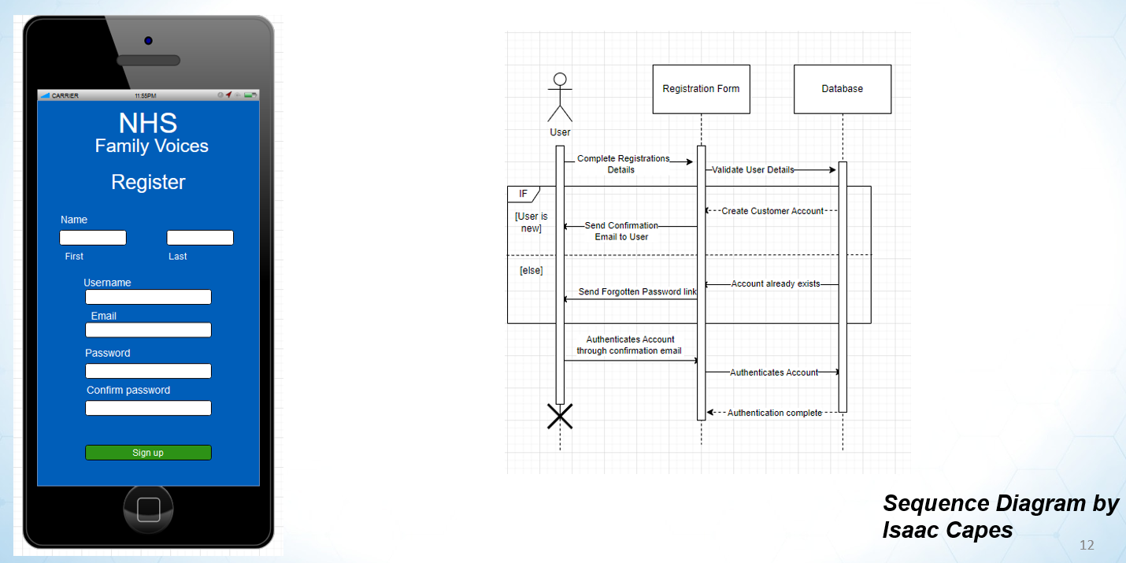
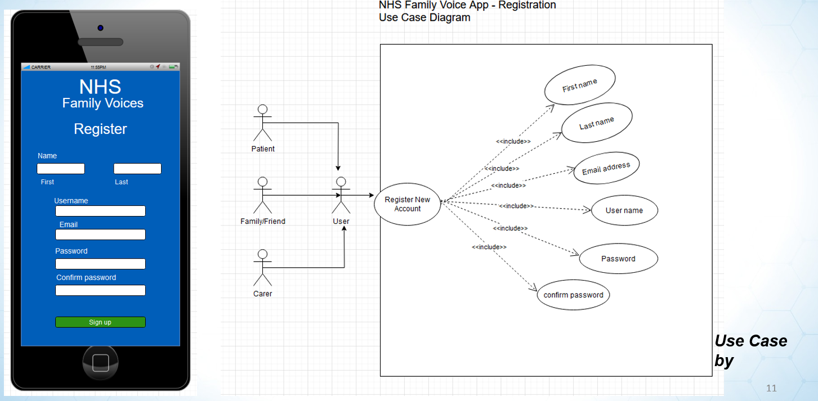
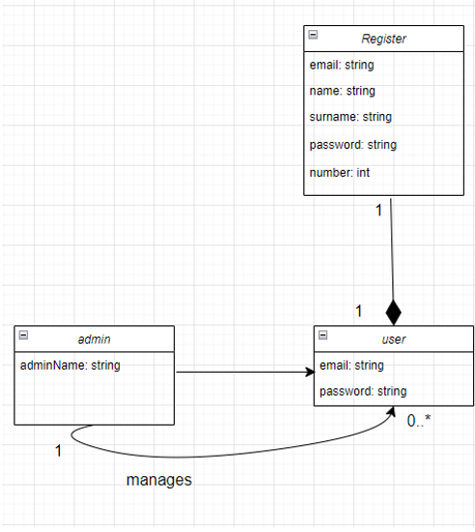
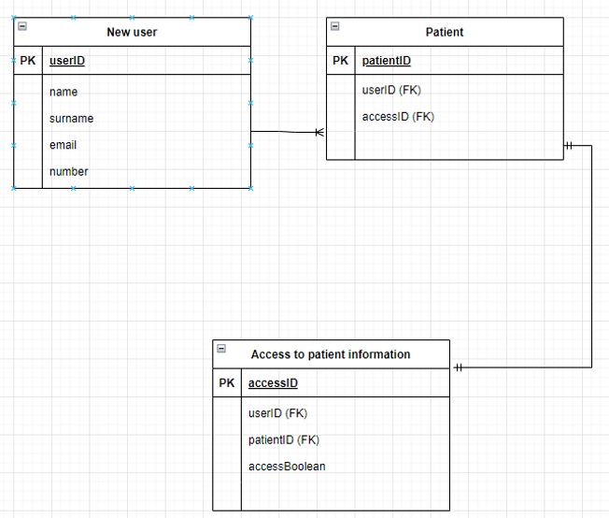
UML – registration diagrams
Use case
ERD

Slide 23
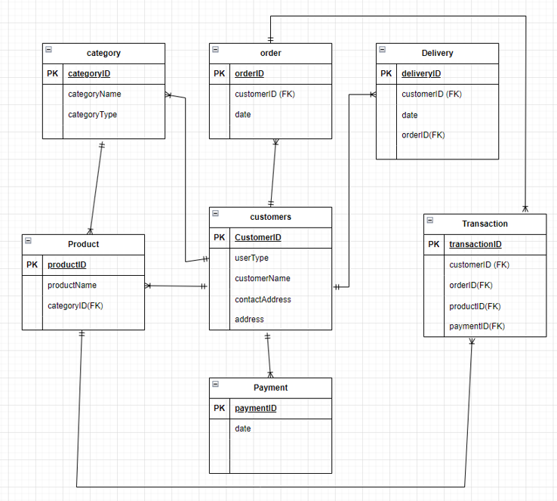
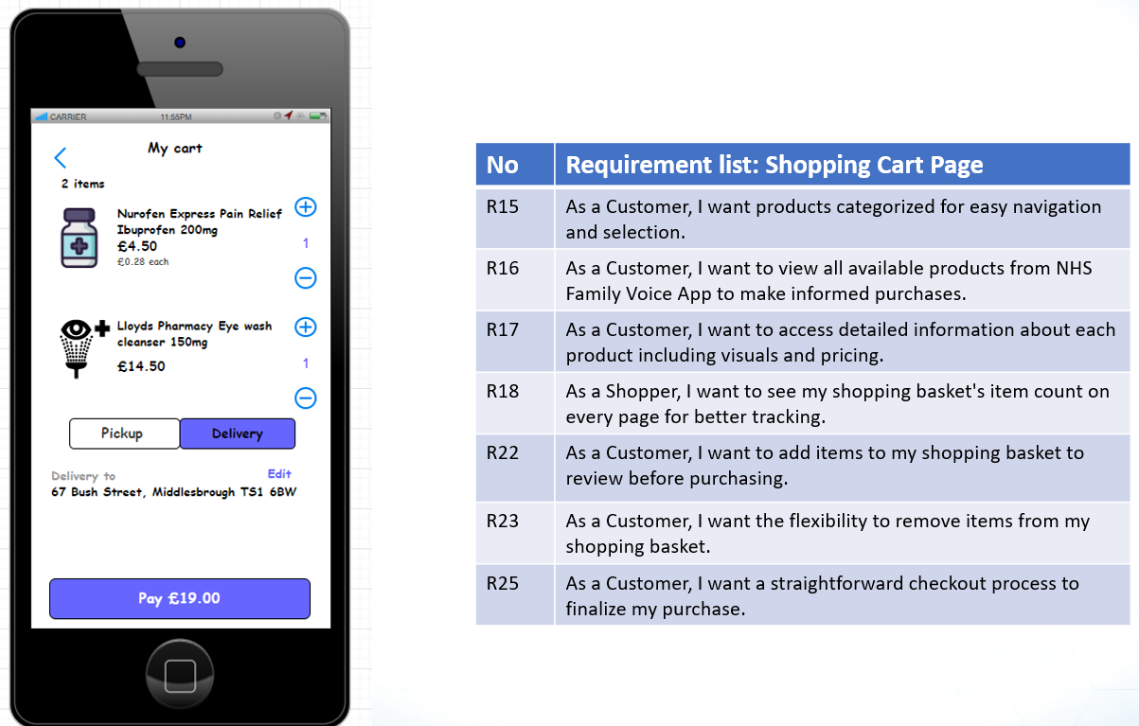
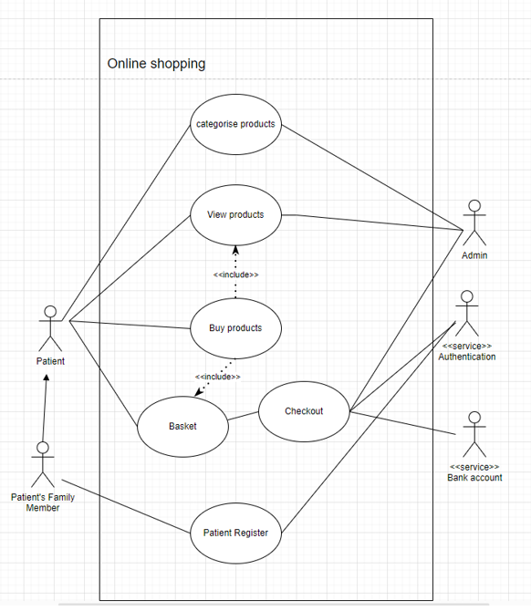
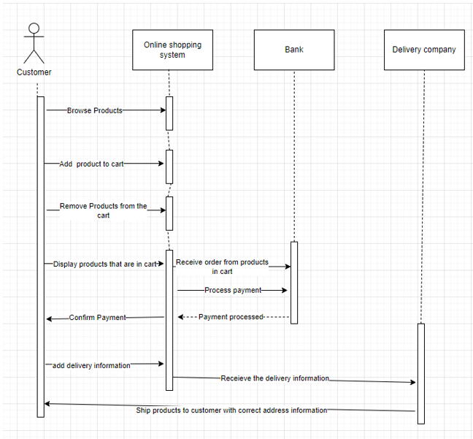
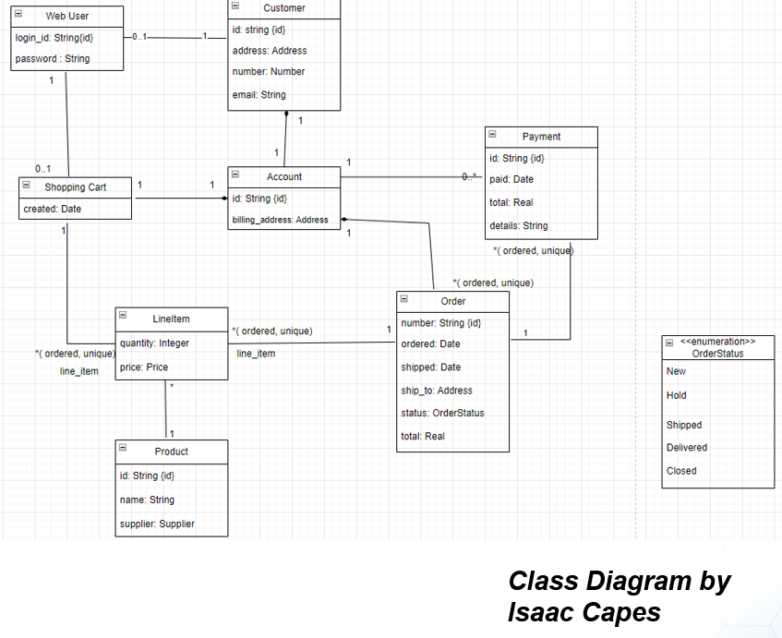
UML – Shopping cart
ERD
Use case
Sequence
diagram

Slide 24
UML Conclusion
As you can see from the diagrams, once again they are very similar. With this assessment, I got 26.25/37.5. It was peer assessed by the group so points were dependant on contribution. For the group presentation, as a group we got 8.75/12.5. So in total I got 35/50. There was also a regulations and security report for the NHS app, I got 8/10. This was also a very stressful assignment at university because my team would not turn up most of the time and the teaching was not the best. So overall for this part of the module, I got 43/50.
The SQL assignment was part of the same module at university.

Slide 25
SQL - Introduction
This was a solo project along side the UML assessment. It ranged from basic SQL queries to some advanced ones. I chose my database on the football database because I love football and choosing a database which I enjoyed made me want to learn even more. This was less stressful than the UML assignment

Slide 26
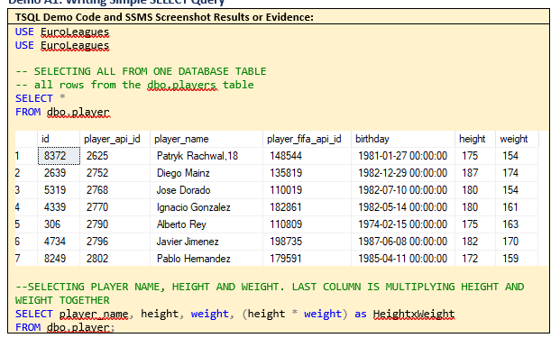
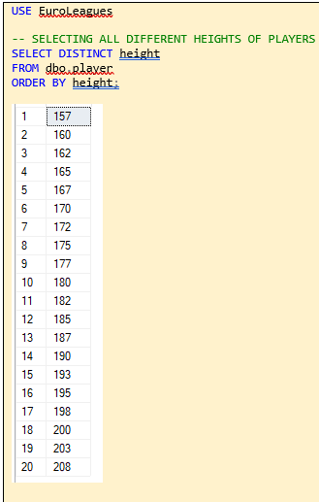
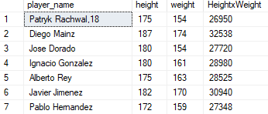
SQL – basic queries

Slide 27
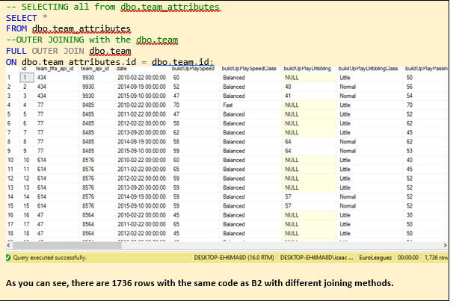
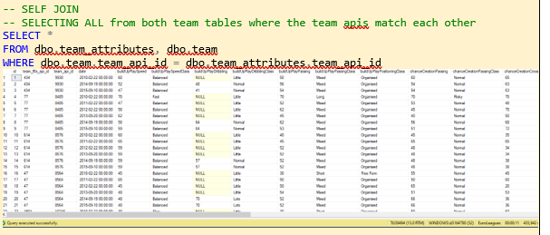
SQL – Joining queries
Self join
Outer join

Slide 28
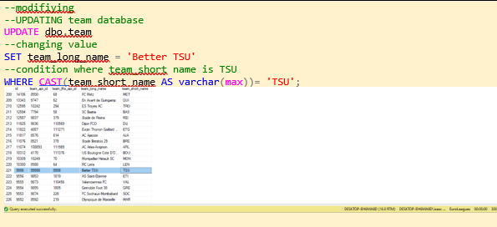
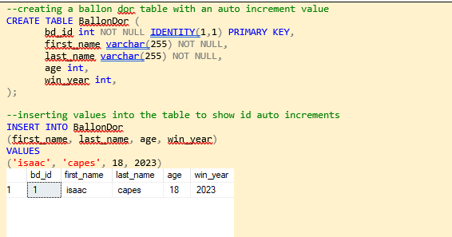
SQL – modify data
Automatic numbering for a column. One of the
most important things to learn in SQL.
Updating tables

Slide 29
SQL - Conclusion
There are many more queries in the SQL file that I have provided. They range from really basic queries, joining tables, working with data types, modifying data, and using built in functions. I passed this assessment with 32.8/40 which I think I could have done better on but that comes with more experience and learning.

Slide 30
Programming – python
This was also another assignment at university. For my python code, I gained 70/100, this ranged from basic string manipulation to error handling. From past experience using C#, the language concepts are similar but the python syntax was probably the hardest thing to learn. There was also a password strength tester included which was a bit more difficult and had certain requirements to meet. In addition, I coded a very basic encrypter and decrypter. I did this by getting the ASCII code and adding 3 to encrypt, and subtracting 3 for the decrypt. Finally, I coded a Password manager. This was stored in a text file and using encryption.

Slide 31
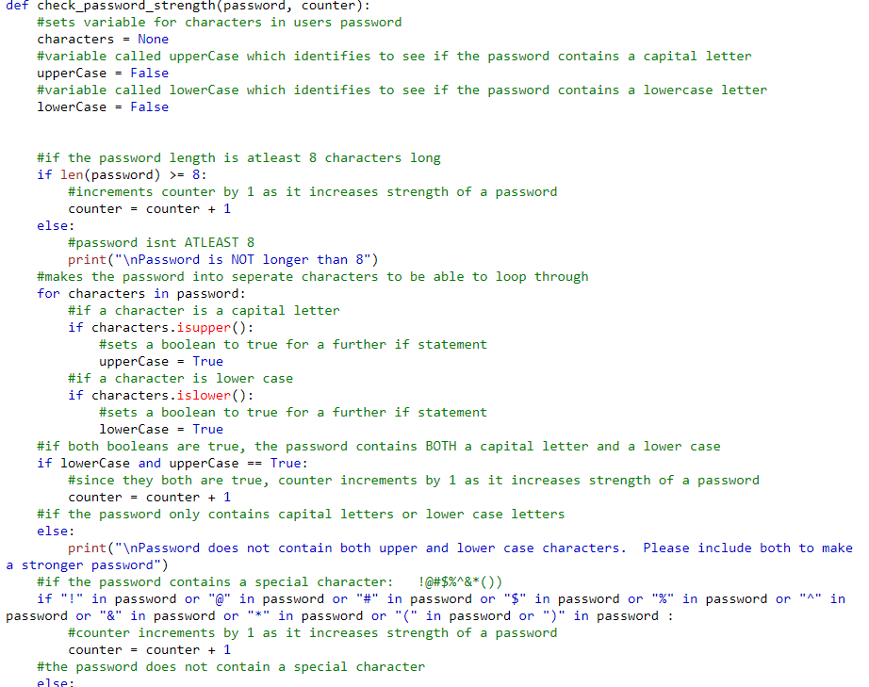
Python – password strength test
The code is explained by
the comments above. The code also uses in built functions like .isupper().

Slide 32
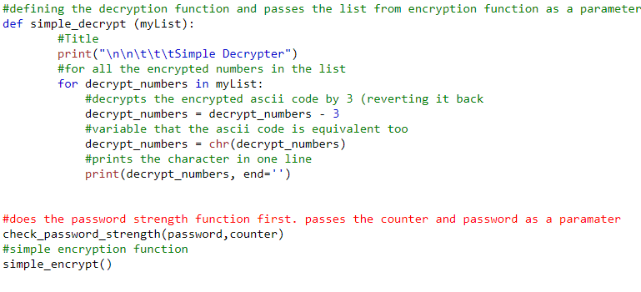
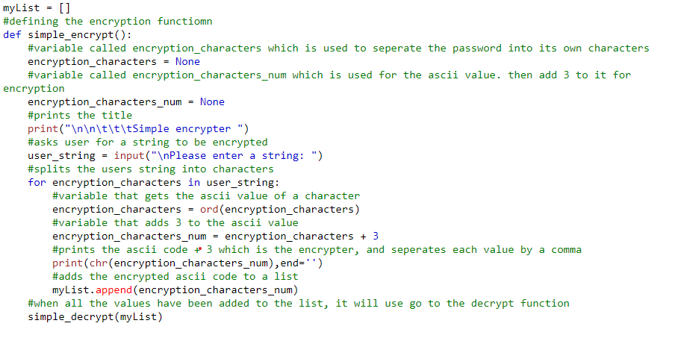
Programming – encrypter & decrypter

Slide 33
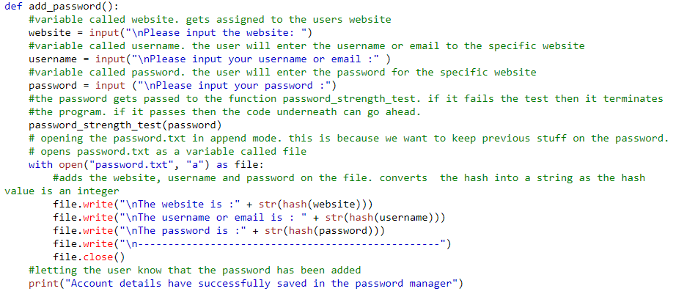
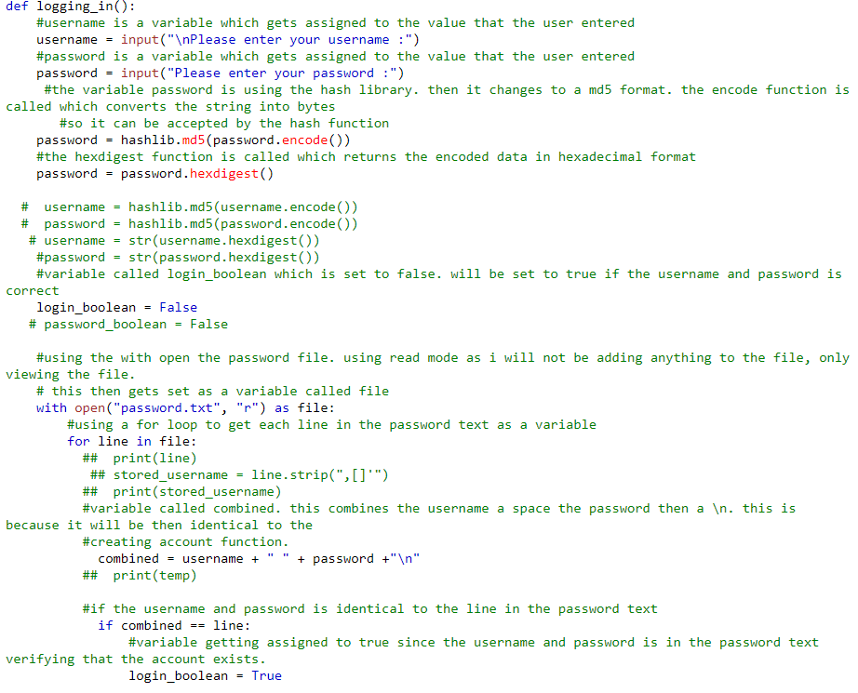
Programming – Password manager
This is logging in. There is also a create account function
Adding the password to the text file

Slide 34
Contact Isaac Capes
Email – isaac.capes05@gmail.com
Phone number - 07511537078

